Slide 1
DIELECTRIC MATERIALS
DR. ARCHANA SHARMA

Slide 2
WHAT ARE DIELECTRICS ?
Conductors : substances that contain an unlimited supply of charges that are free to move through the material. Eg. Metals
Insulators: which do not have free electrons or the number of electrons are too low, the electrons are tightly bound to atom. Eg. Plastic, paper
Dielectrics: When potential difference is applied to insulator no electric current flows, even then their behaviour in fields is very important because the presence of the field may change behaviour of an insulator. Eg. Mica, glass
When certain non-conducting materials are used to fill the space between two conductors of a capacitor the capacitance is found to increase. The insulators whose behaviour gets modified in the electric field are called dielectrics.

Slide 3
When change in behaviour of the dielectric is independent of direction of applied field, the dielectric is called as isotropic,
If the change in behaviour of dielectric depends on direction of applied field then the dielectric is called as anisotropic.
If a dielectric is kept in an electric field, then the field exerts a force on each charged particle. The positive particles are pushed in one direction while negative particles in the opposite direction.
Hence, the positive and negative parts of each molecule are displaced from their equilibrium positions in opposite directions.
The relative displacement of charges give rise to dipole generation and the dielectric is said to be polarized.
The dielectrics are classified into two types:
Polar molecules
Non polar molecules

Slide 4
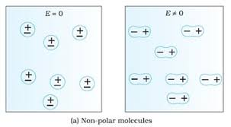
NON-POLAR DIELECTRICS
A molecule in which the centres of gravity of positive and negative charges coincide, and thus for which the inherent dipole moment is zero, is called a non polar molecule.
Eg: H₂, O₂, CH₄,C₆H₆ etc.

Slide 5
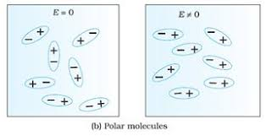
POLAR DIELECTRICS
Molecules that have no centre of symmetry i.e. for which the distributions of two kinds of charges are different, so that the positive and negative charges are centred at a point separated by a distance, therefore possess a net dipole moment are called polar molecules. H₂O, CHCl₃, C₆H₅Cl, C₂H₆OH etc. are some examples of polar molecules.
Polar nature of dielectric materials is measured in terms of its permanent dipole moment.

Slide 6
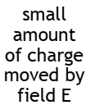
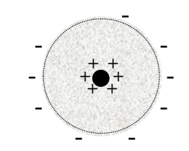
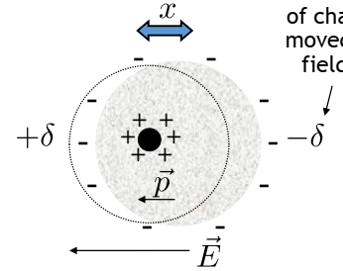
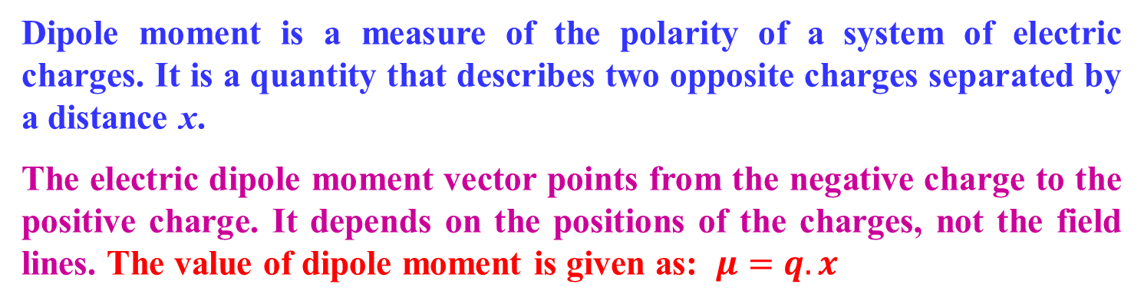
WHAT IS A DIPOLE
Dipole moment is a measure of the polarity of a system of electric charges. It is a quantity that describes two opposite charges separated by a distance x.
The electric dipole moment vector points from the negative charge to the positive charge. It depends on the positions of the charges, not the field lines. The value of dipole moment is given as: $μ=q. x$

Slide 7
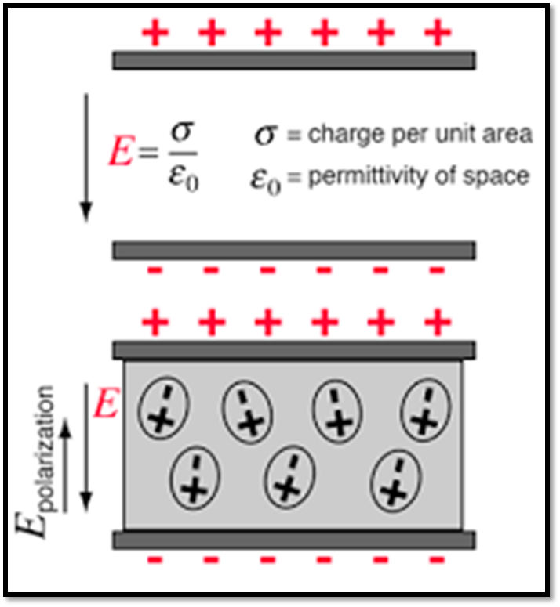
POLARIZATION
Dielectrics contain bound charges. The bound charges may be able to move slightly (in opposite directions) when an Electric field is applied.
No applied field: The centroids of the positive and negative charges coincide → no external E-field.
In an Electric field: The electrons move a small distance in one direction and the nucleus moves in the opposite direction.
Polarization is number of dipole moments induced per unit volume. P=µ/V.

Slide 8
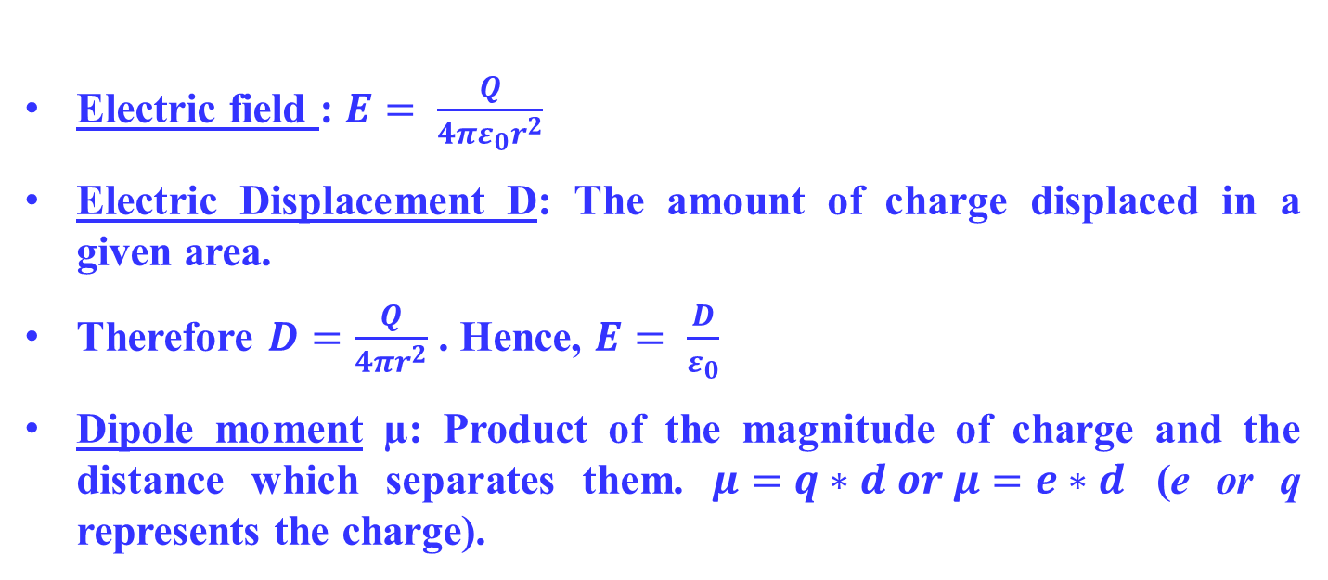
FEW IMPORTANT TERMS/ FORMULAES
Electric field : $E= \frac{Q}{4πε_{0}r^{2}}$
Electric Displacement D: The amount of charge displaced in a given area.
Therefore $D=\frac{Q}{4πr^{2}}$ . Hence, $E= \frac{D}{ε_{0}}$
Dipole moment µ: Product of the magnitude of charge and the distance which separates them. $μ=q∗d or μ=e∗d$ (e or q represents the charge).

Slide 9
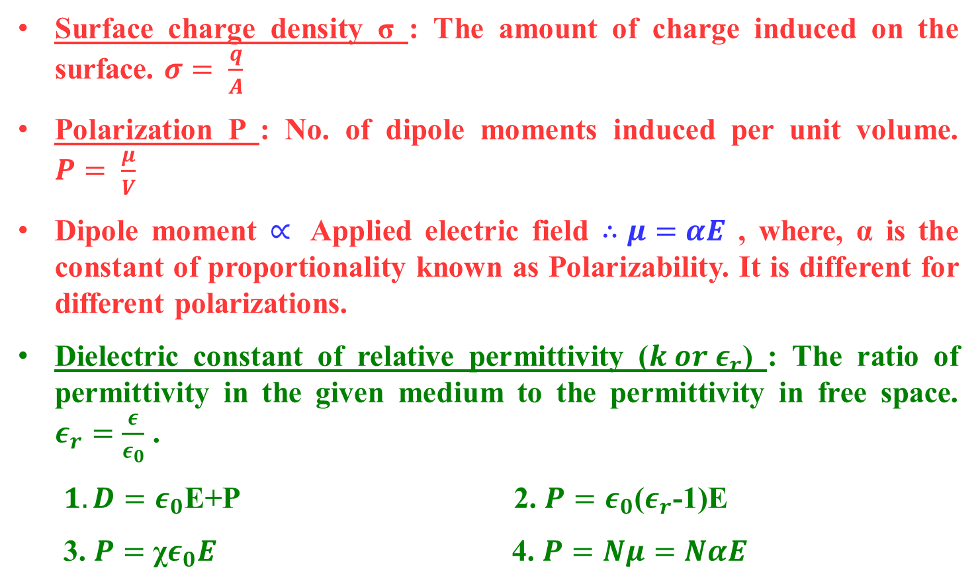
FEW IMPORTANT TERMS/ FORMULAES
Surface charge density σ : The amount of charge induced on the surface. $σ= \frac{q}{A}$
Polarization P : No. of dipole moments induced per unit volume. $P= \frac{μ}{V}$
Dipole moment $∝$ Applied electric field $∴μ=αE$ , where, α is the constant of proportionality known as Polarizability. It is different for different polarizations.
Dielectric constant of relative permittivity ($k or ε_{r}$) : The ratio of permittivity in the given medium to the permittivity in free space. $ε_{r}=\frac{ε}{ε_{0}}$ .
$1. D=ε_{0}$E+P 2. $P=ε_{0}$($ε_{r}$-1)E
3. $P=$ χ$ε_{0}E$ 4. $P=Nμ=NαE$

Slide 10
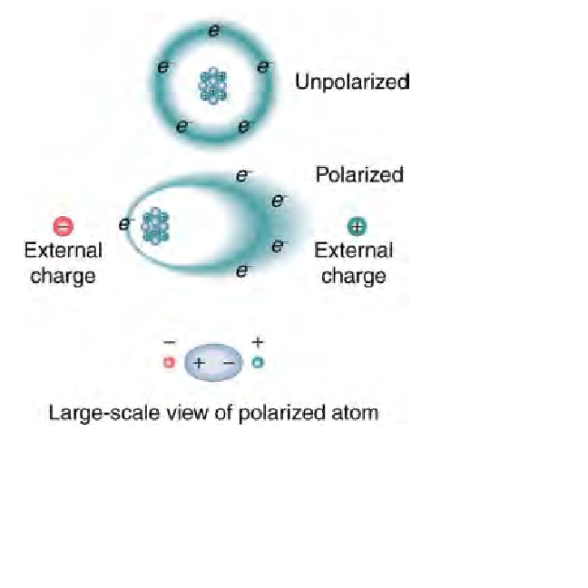
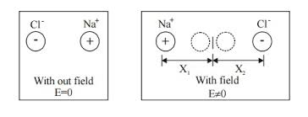
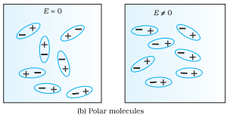
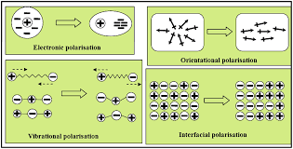
TYPES OF POLARIZATION
Electronic Polarization 2. Ionic Polarization
3. Orientation Polarization 4. Space charge Polarization

Slide 11
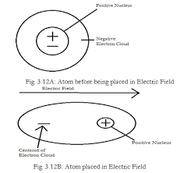
ELECTRONIC POLARIZATION
Consider a single atom of atomic number Z ; +e coulomb charge of each proton in the nucleus; -e coulomb is the charge of each electron surrounding the nucleus.
Electrons form a spherical cloud of negative charge surrounds the positively charged nucleus.
The charge of nucleus is +Ze coulombs and charge of the negative cloud of electrons is -Ze coulombs.
Assume that the negative charge of the electrons cloud is homogeneously distributed on a sphere of radius R. When there is no influence of any external electric field, the center of this sphere and center of nucleus of the atom coincide.

Slide 12
If an external electric field E is applied on the atom →atom shifts towards negative intensity of the field and the electron cloud is shifted towards the positive intensity of the field.
The center of nucleus and center of electrons cloud are separated → Coulomb’s law of attraction acts between them.
At a separation of x, the forces acting on the nucleus or electron cloud due to external electric field and due to Coulomb law become same and opposite.
Hence, the electrostatic force acting on the nucleus would be +ZeE. Now the nucleus has been shifted from the center of electrons cloud by a distance x.

Slide 13


According to Gauss’s law, the force due to negative electron cloud acting upon the positive nucleus would only be due to the portion of the cloud enclosed by the sphere of radius x.
The volume of the sphere of radius x is (4/3)πx³ and the volume of the sphere of radius R is (4/3)πR³. Now total negative charge of the electron cloud is -Ze and we have already considered that it is uniformly distributed throughout the volume of the cloud.
Hence, the quantity of negative charge enclosed by the sphere of radius x is,
Only this much charge will apply coulombic force on the nucleus. So, according to Coulomb’s law the force would be

Slide 14
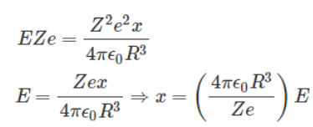


At equilibrium condition,
Now the dipole moment of the nucleus is Zex as dipole moment is the product of charge of the nucleus and the distance of displacement. Now, putting the expression of x in the expression of dipole moment, we get,
The polarization is defined as the number of dipole moments per unit volume of the material. If N is the number of dipole moments per unit volume, the polarization would be,
Hence, we can say that the electronic polarization is dependent upon the radius of the atom and the number of atoms presents in unit volume of the material.

Slide 15
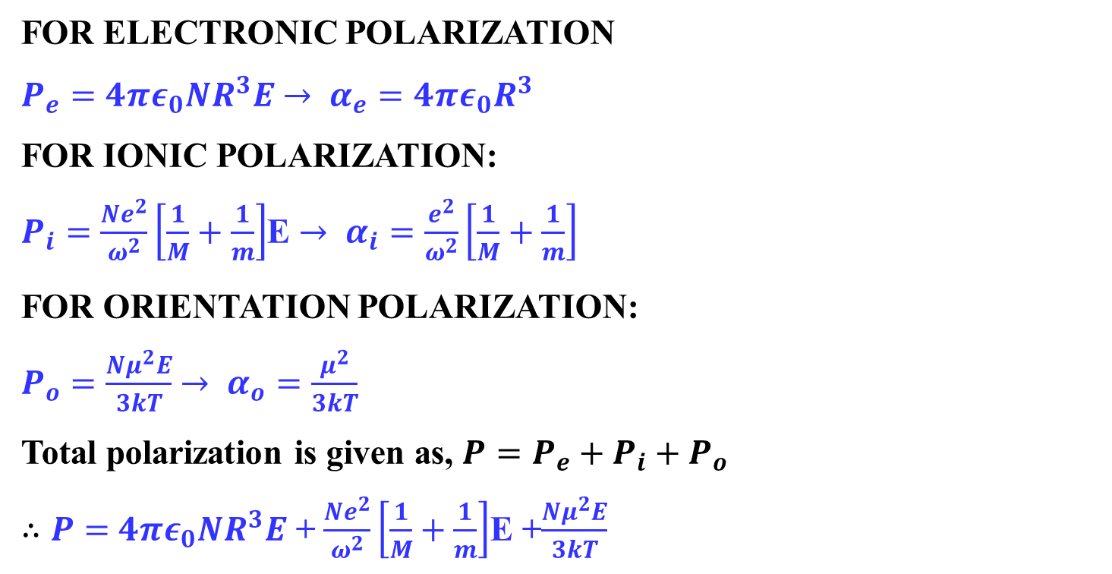
FEW MORE EXPRESSIONS
FOR ELECTRONIC POLARIZATION
$P_{e}=4πε_{0}NR^{3}E$ $→ α_{e}=4πε_{0}R^{3}$
FOR IONIC POLARIZATION:
$P_{i}=\frac{Ne^{2}}{ω_{}^{2}}\left[\frac{1}{M}+\frac{1}{m}\right]$E $→ α_{i}=\frac{e^{2}}{ω_{}^{2}}\left[\frac{1}{M}+\frac{1}{m}\right]$
FOR ORIENTATION POLARIZATION:
$P_{o}=\frac{Nμ^{2}E}{3kT}$ $→ α_{o}=\frac{μ^{2}}{3kT}$
Total polarization is given as, $P=P_{e}+P_{i}+P_{o}$
$∴P=$ $4πε_{0}NR^{3}E$ + $\frac{Ne^{2}}{ω_{}^{2}}\left[\frac{1}{M}+\frac{1}{m}\right]$E +$\frac{Nμ^{2}E}{3kT}$

Slide 16
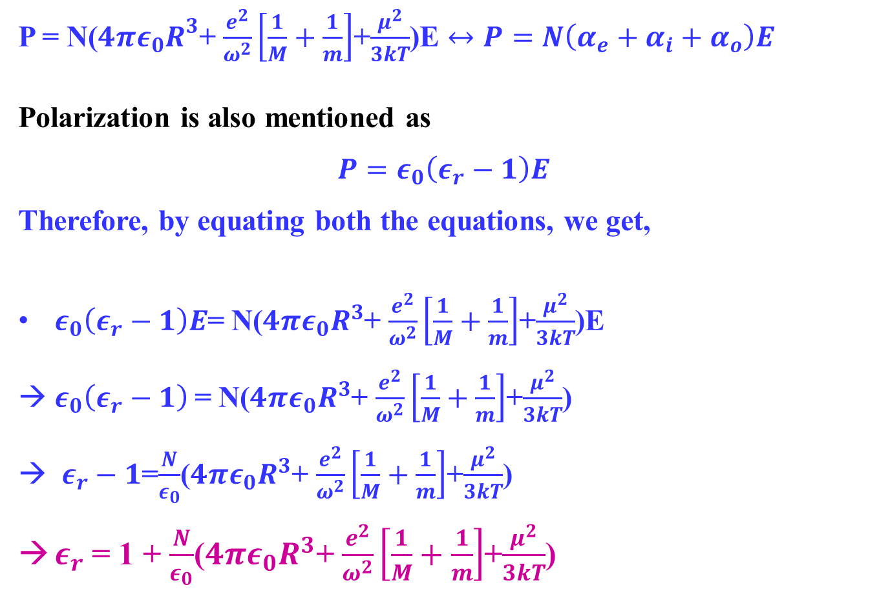
P = N($4πε_{0}R^{3}$+ $\frac{e^{2}}{ω_{}^{2}}\left[\frac{1}{M}+\frac{1}{m}\right]$+$\frac{μ^{2}}{3kT}$)E $↔P=N\left(α_{e}+α_{i}+α_{o}\right)E$
Polarization is also mentioned as
$$P=ε_{0}\left(ε_{r}−1\right)E$$
Therefore, by equating both the equations, we get,
$ε_{0}\left(ε_{r}−1\right)E$= N($4πε_{0}R^{3}$+ $\frac{e^{2}}{ω_{}^{2}}\left[\frac{1}{M}+\frac{1}{m}\right]$+$\frac{μ^{2}}{3kT}$)E
$ε_{0}\left(ε_{r}−1\right)$= N($4πε_{0}R^{3}$+ $\frac{e^{2}}{ω_{}^{2}}\left[\frac{1}{M}+\frac{1}{m}\right]$+$\frac{μ^{2}}{3kT}$)
$ε_{r}−1$=$\frac{N}{ε_{0}}$($4πε_{0}R^{3}$+ $\frac{e^{2}}{ω_{}^{2}}\left[\frac{1}{M}+\frac{1}{m}\right]$+$\frac{μ^{2}}{3kT}$)
$ε_{r}$ = 1 + $\frac{N}{ε_{0}}$($4πε_{0}R^{3}$+ $\frac{e^{2}}{ω_{}^{2}}\left[\frac{1}{M}+\frac{1}{m}\right]$+$\frac{μ^{2}}{3kT}$)

Slide 17
INTERNAL FIELDS IN SOLIDS
Gases: Atoms are in constant random motion separated by a large distances (less interaction). In an external field, the field intensity will be same as that of the applied field.
Solids and Liquids: The atoms are in a close proximity, so they are surrounded by polarized atoms. In dielectric solids, the atoms or molecules not only experience the external applied electric field but also the electric field produced by the dipoles.
The resultant electric field acting on the atoms or molecules of dielectric substance is called the local field or an internal field.
The internal field E_{i} is : The sum of the electric fields created by the neighbouring atoms and the applied field and is given as E_{i} =E+E´ where E´ is the field due to neighbouring atoms.
The value of E´ can be evaluated by the summation of all the effects of surrounding atoms.

Slide 18
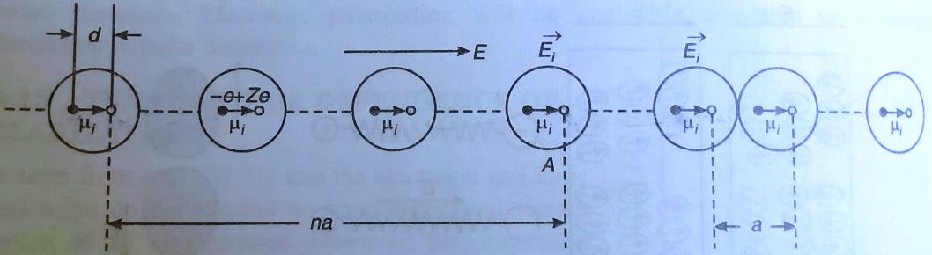
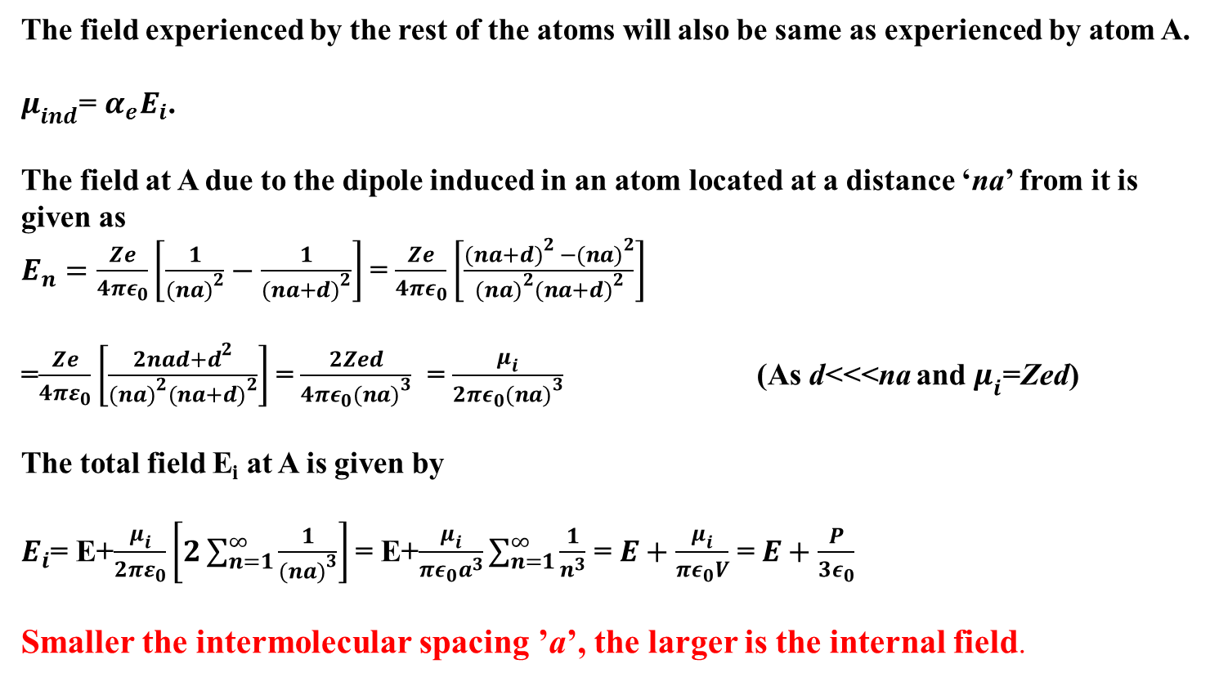
DERIVATION OF THE INTERNAL FIELD
If an external field is applied in the direction parallel to the string (one dimensional array of atoms), we need to determine the internal field E_{i} on an atom.
The field experienced by the rest of the atoms will also be same as experienced by atom A.
$μ_{ind}$= $α_{e}E_{i}$.
The field at A due to the dipole induced in an atom located at a distance ‘na’ from it is given as
$E_{n}=\frac{Ze}{4πε_{0}}\left[\frac{1}{{(na)}^{2}}−\frac{1}{{(na+d)}^{2}}\right]$ = $\frac{Ze}{4πε_{0}}\left[\frac{{(na+d)}^{2 }−{(na)}^{2}}{{(na)}^{2}{(na+d)}^{2}}\right]$
=$\frac{Ze}{{4πε}_{0}}\left[\frac{2nad+d^{2}}{{(na)}^{2}{(na+d)}^{2}}\right]$ = $\frac{2Zed}{{4πε}_{0}{(na)}^{3}}$ = $\frac{μ_{i}}{2πε_{0}{(na)}^{3}}$ (As d<<<na and $μ_{i}$=Zed)
The total field E_{i} at A is given by
$E_{i}$= E+$\frac{μ_{i}}{2πε_{0}}\left[2\sum_{n=1}^{∞}{\frac{1}{{(na)}^{3}}}\right]$ = E+$\frac{μ_{i}}{πε_{0}a^{3}}\sum_{n=1}^{∞}{\frac{1}{n^{3}}}$ = $E+\frac{μ_{i}}{{πε}_{0}V}$ = $E+\frac{P}{3ε_{0}}$
Smaller the intermolecular spacing ’a’, the larger is the internal field.

Slide 19
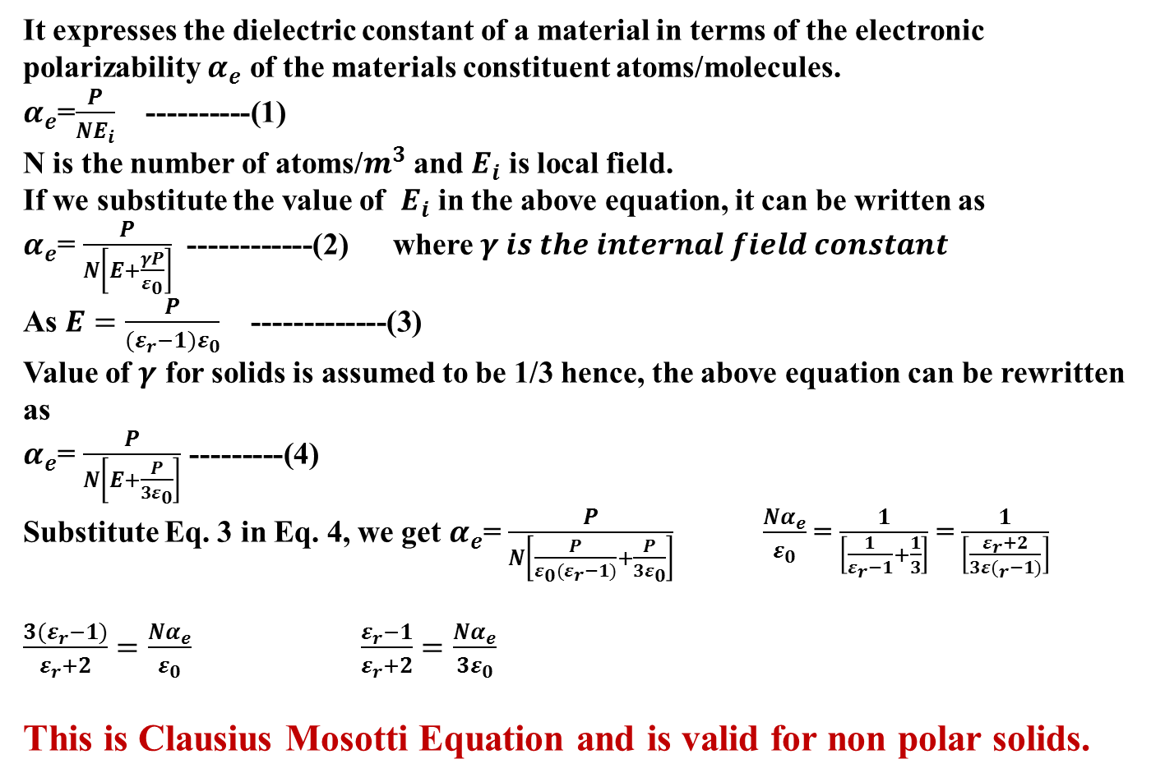
CLAUSIUS MOSOTTI EQUATION
It expresses the dielectric constant of a material in terms of the electronic polarizability $α_{e}$ of the materials constituent atoms/molecules.
$α_{e}$=$\frac{P}{NE_{i}}$ ----------(1)
N is the number of atoms/$m^{3}$ and $E_{i}$ is local field.
If we substitute the value of $E_{i}$ in the above equation, it can be written as
$α_{e}$= $\frac{P}{N\left[E+\frac{γP}{ε_{0}}\right]}$ ------------(2) where $γ is the internal field constant$
As $E=\frac{P}{(ε_{r}−1)ε_{0}}$ -------------(3)
Value of $γ$ for solids is assumed to be 1/3 hence, the above equation can be rewritten as
$α_{e}$= $\frac{P}{N\left[E+\frac{P}{3ε_{0}}\right]}$ ---------(4)
Substitute Eq. 3 in Eq. 4, we get $α_{e}$= $\frac{P}{N\left[\frac{P}{ε_{0}(ε_{r}−1)}+\frac{P}{3ε_{0}}\right]}$ $\frac{Nα_{e}}{ε_{0}}$ = $\frac{1}{\left[\frac{1}{ε_{r}−1}+\frac{1}{3}\right]}$ = $\frac{1}{\left[\frac{ε_{r}+2}{{3ε(}_{r}−1)}\right]}$
$\frac{3(ε_{r}−1)}{ε_{r}+2}=\frac{Nα_{e}}{ε_{0}}$ $\frac{ε_{r}−1}{ε_{r}+2}=\frac{Nα_{e}}{3ε_{0}}$
This is Clausius Mosotti Equation and is valid for non polar solids.

Slide 20
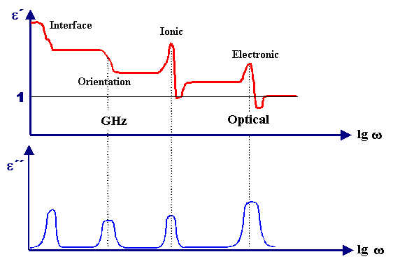
FREQUENCY DEPENDENCE OF POLARIZATION
When a dielectric is placed in an alternating field, the dielectric gets polarized → The total polarization depends on the ability of dipole to orient themselves in field direction.
Electronic polarization is fastest and persists at ~10¹³-10¹⁵ Hz.
Ionic polarization is sluggish; occurs at ~10⁹-10¹³ Hz.
Orientation polarization occurs below 10⁹ Hz.
Space charge polarization occurs at frequencies below 10 Hz
The average time taken by the dipole to orient in the field direction is known as relaxation time.
The reciprocal of relaxation time is known as relaxation frequency.
https://www.tf.uni-kiel.de/matwis/amat/elmat_en/kap_3/backbone/r3_3_5.html

Slide 21
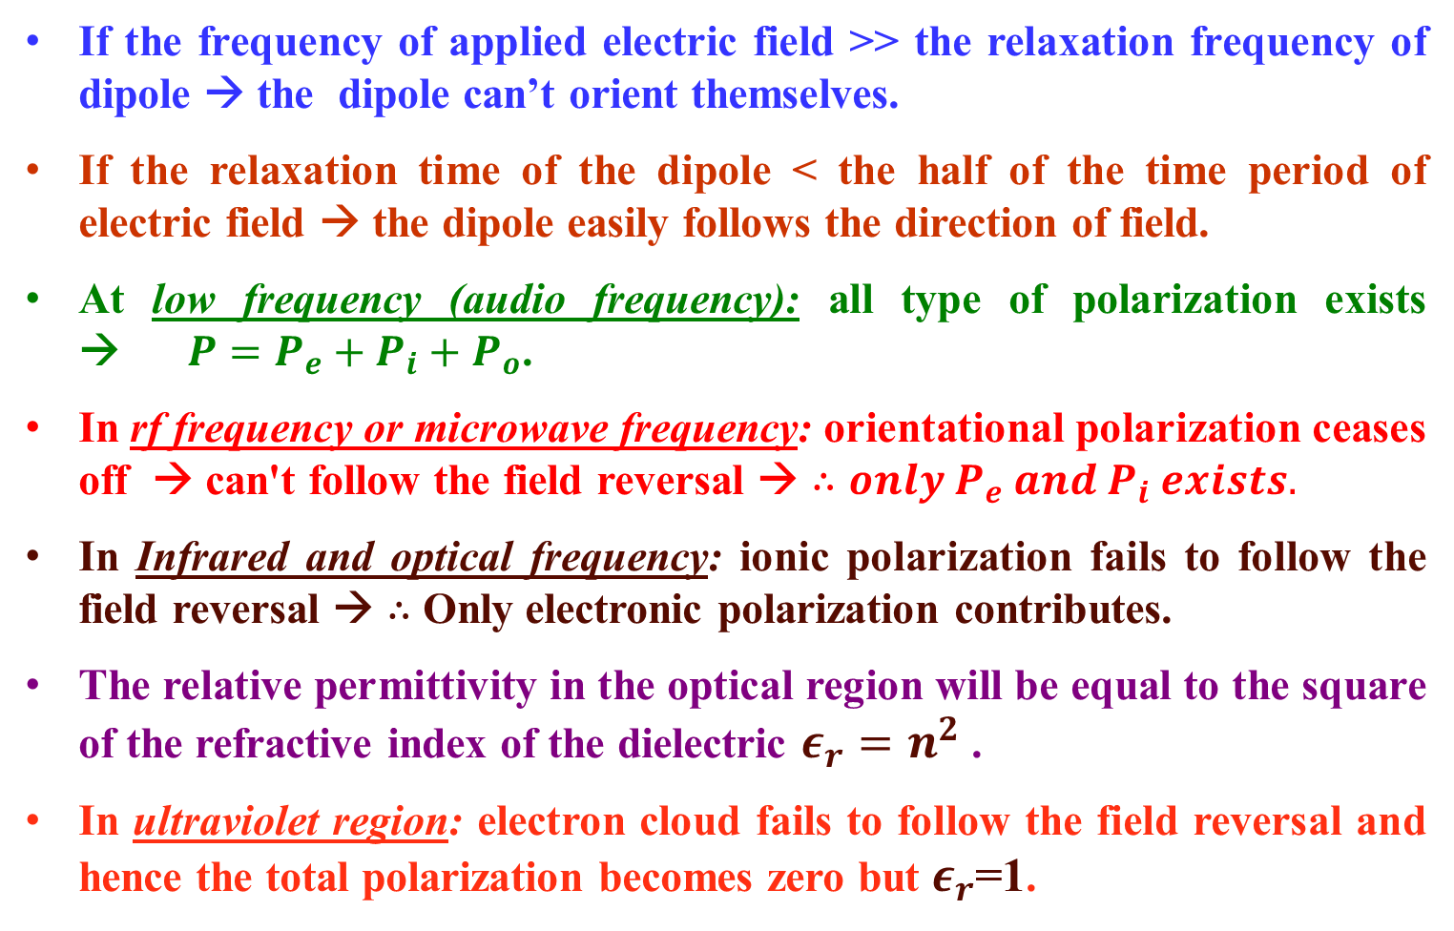
If the frequency of applied electric field >> the relaxation frequency of dipole → the dipole can’t orient themselves.
If the relaxation time of the dipole < the half of the time period of electric field → the dipole easily follows the direction of field.
At low frequency (audio frequency): all type of polarization exists → $P=P_{e}+P_{i}+P_{o}$.
In rf frequency or microwave frequency: orientational polarization ceases off → can't follow the field reversal → $∴only P_{e} and P_{i} exists.$
In Infrared and optical frequency: ionic polarization fails to follow the field reversal → $∴$ Only electronic polarization contributes.
The relative permittivity in the optical region will be equal to the square of the refractive index of the dielectric $ε_{r}=n^{2}$ .
In ultraviolet region: electron cloud fails to follow the field reversal and hence the total polarization becomes zero but $ε_{r}$=1.

Slide 22
DIELECTRIC STRENGTH
Dielectrics normally behave as insulators. Their insulating property breaks down and they start to conduct above a given electric field. This property of dielectrics is known as Dielectric strength.
This limits the maximum potential allowed between the two conductors and hence from Q=CV, the maximum charge and energy that can be stored.
Dielectric strength is the voltage a material can withstand before breakdown occurs. Dielectric strength is measured through the thickness of the material (taking care to avoid surface effects) and is normally expressed as a voltage gradient (volts per unit length).

Slide 23
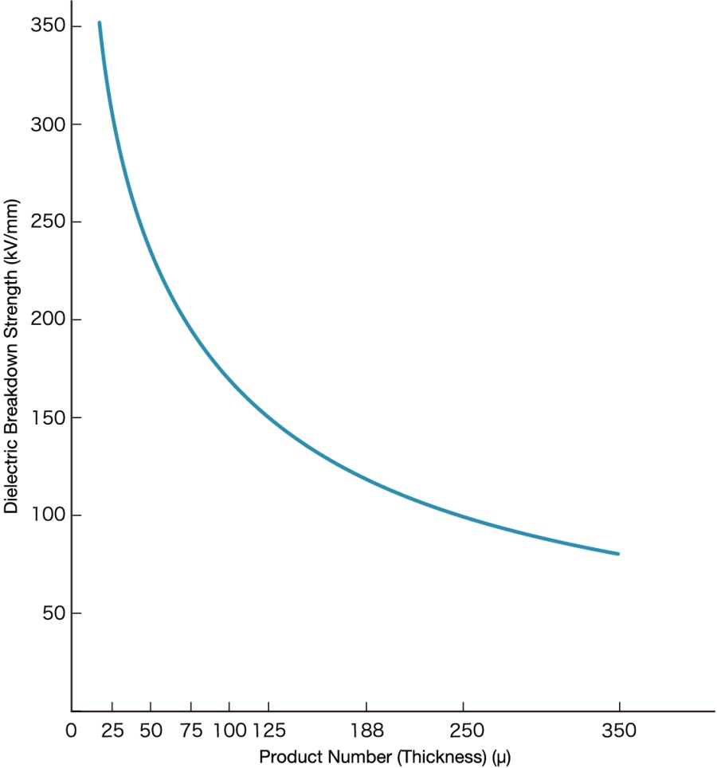
The voltage that may be applied to a rubber-covered conductor is dependent on the thickness and the quality of the rubber covering. Other factors being equal, the thicker the insulation, the higher may be the applied voltage.
Dielectric strength of few materials
Air 3 MV/m
Paper 16 MV/m
Rubber 20 MV/m roughly
Water 30 MV/m
Teflon 60 MV/m
https://www.films.toray/en/technical/lumirror/lum_003.html

Slide 24
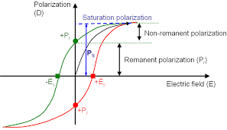
FERROELECTRICITY
Spontaneous polarization is a property shown by anisotropic crystals.
It occurs without the application of any external field.
It occurs in polar dielectrics, where the centre of gravity of negative and positive charges don’t coincide and hence, results in a resultant dipole moment.
https://www.globalsino.com/EM/page3544.html

Slide 25
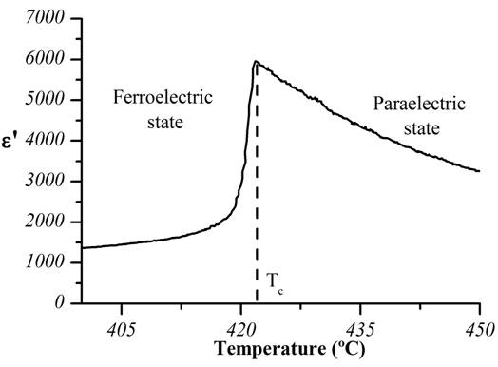
CHARACTERISTICS OF FERROELECTRICS
MATERIALS:
They possess high values of permittivity in the range 1000-10000.
Static dielectric constant of ferroelectric materials change with temperature (Curie Weiss law)
The dielectric polarization depends non linearly on the applied electric field.

Slide 26
APPLICATION OF DIELECTRICS
DIELECTRIC MATERIALS ARE USED IN MANY APPLICATIONS SUCH AS:
Electronic components such as capacitors (responsible for energy storage properties of the device).
High-k / low-k materials widely used in Semiconductors to enhance performance and reduce device size (where k refers to permittivity or dielectric constant).
Dielectric materials are also used in Display applications (e.g. LCD liquid crystal displays).
Piezoelectrics/Ferroelectrics/MEMs materials are also dielectrics.
Ceramics and Polymers also often exhibit dielectric properties.

Slide 27
THANKs for
the patience

